Slide 1

Learning to Optimally Dodge Punches
Maximilian Drach
Notes:
A Deep Reinforcement Learning Approach to Real-Time Robot Defense Strategies

Slide 2
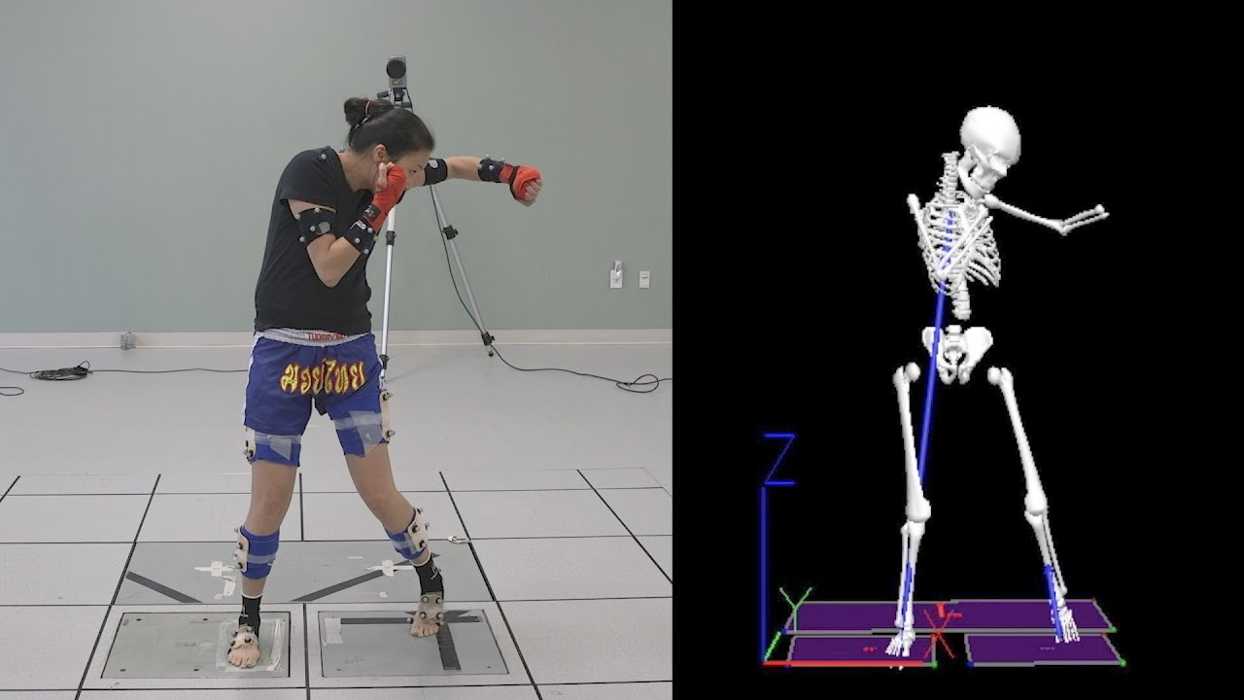
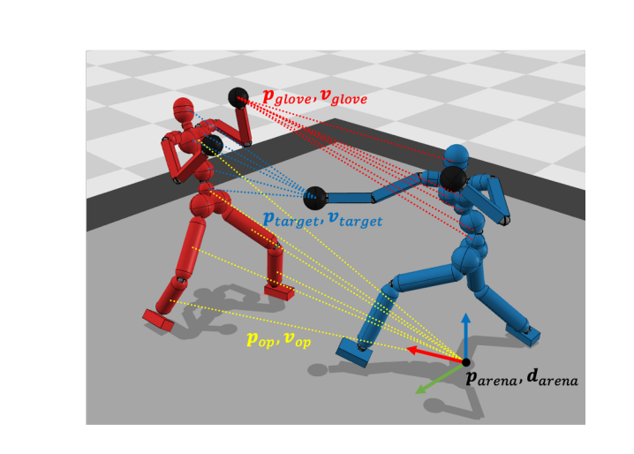
Background
Virtual Fighting Simulation
for VR, AR, and Video Games
Motion Capture
Notes:
Historically -> Researchers Focused on Motion Capture
Using a combination of sensor and camera, they could virtually simulate caputure human movements
These virtual capture could then be used to train RL algorithms for pose generate and movement animation
Think of how old animated movies would use motion capture to create fight scenes
With the advent of high publicly avaible physics simulators and improve deep learning RL algortihms
Researcher were now able to create much more detailed virtual environments
This is were we see a big shift in RL -> virtual simulations
These new environments offer massive advantages because you could have much more granularity in the simulation with the control of motion of specific axis
Talks about knees and joints on the targets
This also concidence with the rise of VR, AR and big companies fund RL research into motion simulation

Slide 3
Deep Deterministic Policy Gradient (DDPG)
Twin Delayed DDPG (TD3)
Continuous Control Task
Actor-Critic Networks
Single Critic Network
Updates Policy Network every Iteration
Suffers from overestimation bias
Continuous Control Task
Actor-Critic Networks
Twin Critic Networks
Delayed Policy Updates
Target Policy Smoothing
Notes:
**Deep Deterministic Policy Gradient (DDPG):**
- Single Critic Architecture: Utilizes a single critic network to estimate the value function.
- Frequent Updates: Performs updates after every iteration, potentially leading to destabilization in certain scenarios.
- Potential Overestimation Bias: May suffer from overestimation bias, especially in the presence of noise.
**Twin Delayed DDPG (TD3):**
- Twin Critics: Introduces twin critics, employing two separate critic networks to reduce overestimation bias and enhance accuracy.
- Delayed Updates: Introduces delayed updates to enhance stability by updating less frequently, contributing to smoother learning.
- Target Policy Smoothing: Incorporates target policy smoothing by adding noise to selected actions during training, promoting smoother and more continuous policy updates.
- Mitigated Overestimation Bias: Twin critics contribute to mitigating overestimation bias, leading to more accurate assessments of action effectiveness.

Slide 4
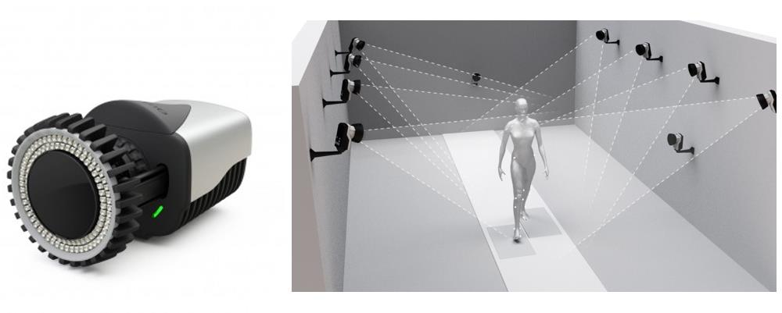
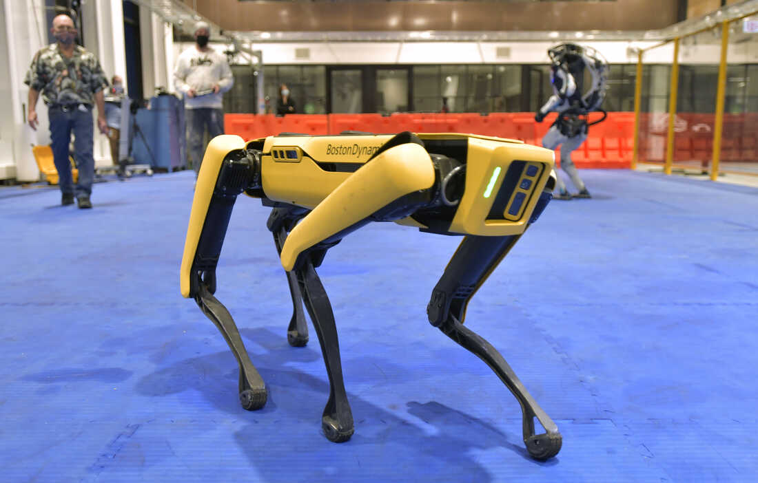
Motivation
Theoretical Environment too Complex
Don’t Account for Physical Parameters
Computationally Impractical
Notes:
The gaps in theoretical environments to complex for the real world applications
Many do not account for simple physical parameter capturing the environments
Camera Framerate
Number of Cameras
Angle of Cameras
Reslution of sensors
This leads to many RL methods being overcomplex for the real world
It takes specialized suits and equipment to track specific joints, think of CGI in movies and funny suits they wear
I want to create an RL model that is based of the physical parameters of the hardware monititoring the enviorment

Slide 5
Objective
Optimally Train an RL Model to Dodge an Incoming Punch
Moving Efficiently
Keeping an Ideal Distance
Not getting Hit!
Notes:
This means moving efficiently and not moving around too much
Keeping an ideal distance away from the punch
Finally not getting hit
This is realtivly easy to acchive virtually, but in real life the punch and targets movement are sperratic as the framerate cause the objects jump around
This means the RL model is trained to the optimally move around given the few frames before impact

Slide 6
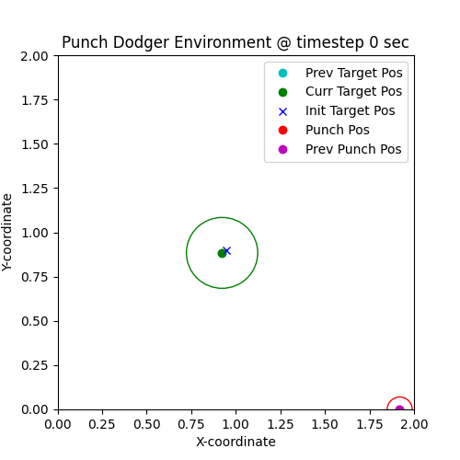
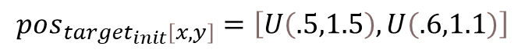
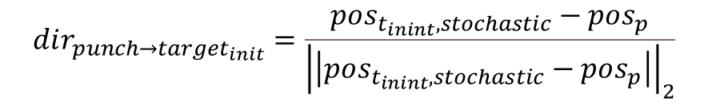
Environment
2x2m Grid
Robot (Target) & Punch Location
$$pos_{target_{init}\left[x,y\right]}=\left[U\left(.5,1.5\right),U\left(.6,1.1\right)\right]$$
$$pos_{target\left[x,y\right]}=pos_{target\left[x,y\right]}+{vector}_{action \left[x,y\right]}$$
$$dir_{punch→target_{init}}=\frac{pos_{t_{inint}, stochastic}−pos_{p}}{{\left|\left|pos_{t_{inint}, stochastic}−pos_{p}\right|\right|}_{2}}$$
$$pos_{p}=pos_{p}+dir_{p→t_{init}}∗vel∗timestep$$
Notes:
2x2 grid to model the 2x2m area a camera can track
The robot or target is generate random in this area
And moves with the inputted action vector from the policy/actor network
The punch starts on the x-axis and moves in a linear path directly towards the intila target position with is slight off centered from actually target to create stochistity in the targeting
I did this because once a punch deviates off its direct course it loose most of its momentum

Slide 7
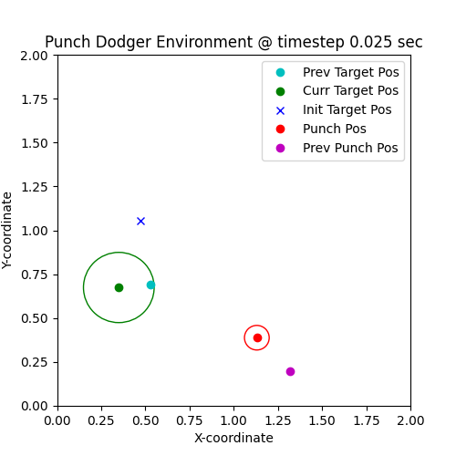
State Spaces
$$Target Location (x,y)∈\left[−10,10\right]$$
$$Previous Target Location(x,y)∈\left[−10,10\right]$$
$$Punch Location (x,y)∈\left[−10,10\right]$$
$$Punch Previous Location (x,y)∈\left[−10,10\right]$$
$$Punch Direction Vector (\hat{x},\hat{y})∈\left[−1,1\right]$$

Slide 8
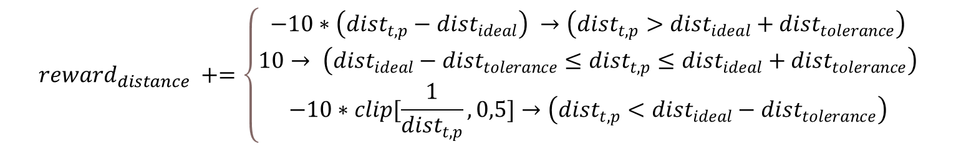

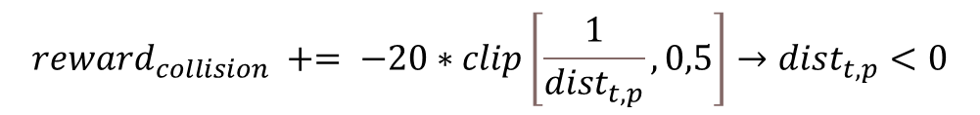
Rewards
Boundary Reward
Distance Reward
Target Moment Reward
Collision Reward
$$reward_{boundry} +=−150$$
$reward_{movement} += −30∗|action_{y}|+ −1∗|action_{x}$|
$$reward_{collision} += −20∗clip\left[\frac{1}{dist_{t,p}},0,5\right]→dist_{t,p}<0$$
$$reward_{collision} += −100→ dist_{t,p−prev}≤.05$$
$$reward_{distance} +=\left\{\begin{aligned}−10∗\left(dist_{t,p}−dist_{ideal}\right) →\left(dist_{t,p}>dist_{ideal}+dist_{tolerance}\right) \\ 10→ \left(dist_{ideal}−dist_{tolerance}≤dist_{t,p}≤dist_{ideal}+dist_{tolerance}\right) \\ −10∗clip[\frac{1}{dist_{t,p}},0,5]→\left(dist_{t,p}<dist_{ideal}−dist_{tolerance}\right)\end{aligned}\right.$$
Notes:
Collision is actually hard to detect virtually because its not always clear if there was a collision
Two ways, is if the punch is inside the target circle or if the circle previous punch is iside the circle, because that means the target moved in to the path of the punch though the camera time steps were unable to pick it up

Slide 9
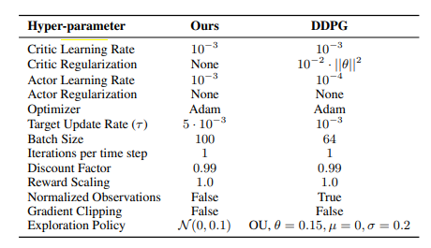
RL Algorithm
Twin Delayed DDPG (TD3) vs Deep Deterministic Policy Gradient (DDPG)
Ornstein–Uhlenbeck Noise vs Normal Noise
Checkpoint Training
Evaluation every 5000 steps
Stops after 100 evaluations of no improvements
Optional Re-optimization
Notes:
- "TD3 offers advantages over traditional DDPG, introducing innovations like Clipped Double-Q Learning, Delayed Policy Updates, and Target Policy Smoothing.“
After comparing the two results it had better generalization than DDPG and wasn’t as prone to over fitting, it also lead to better convergence -> will discuss more in results
While the paper says to use Normal noise, I found OU noise to be performance due to it temporally correlated noise with make a more smooth noise process
The model is evaluated every 5000 steps, and after 100 evaluations of no improvement the learning ends and you are given the option to retrain the model with the highest performance again
This can cause overfitting, but if the model does not converge, you can run again

Slide 10
Results
Average Episode Length = 5 frames
Similar Model Performance
Overfitting Issues

Slide 11
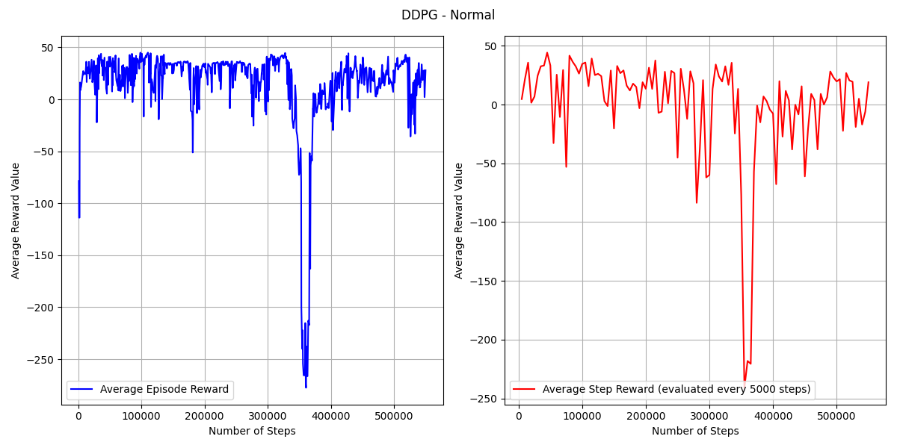
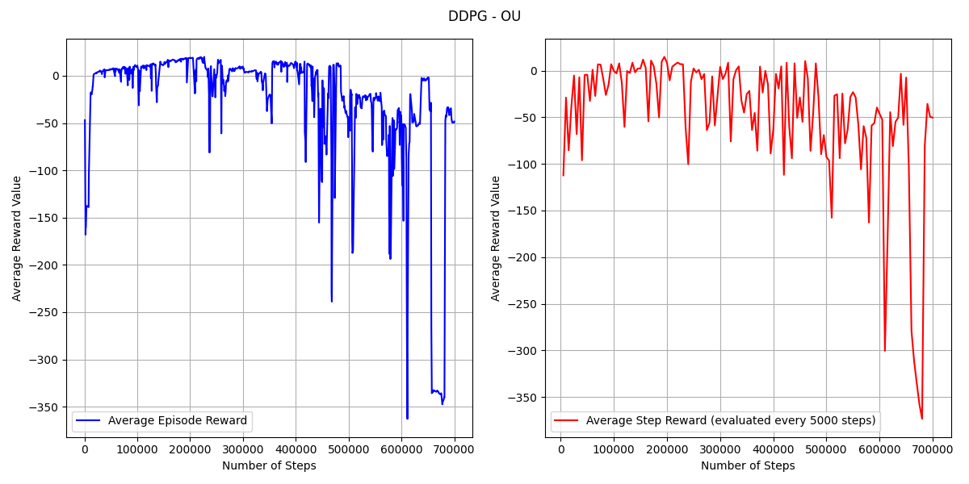
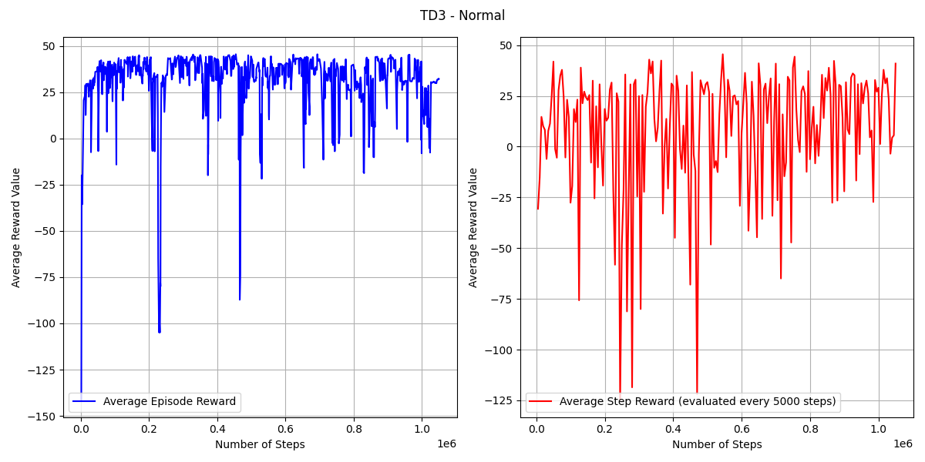
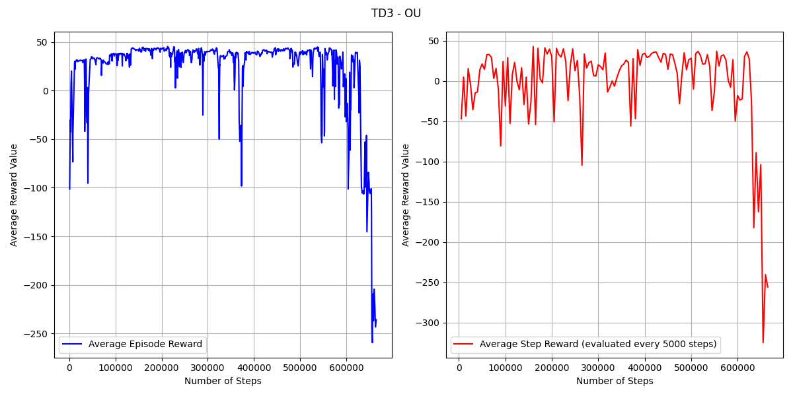

Slide 12
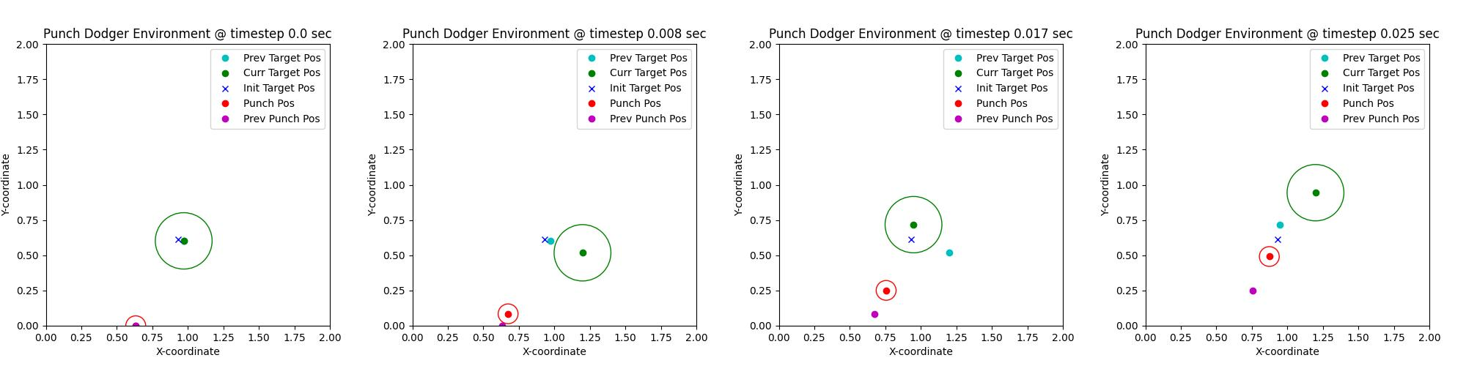
Maintain Ideal Distance From Target
Ideal Distance = .4, Tolerance = .05
Don’t Go out of Bounds
Don’t Get Hit

Slide 13
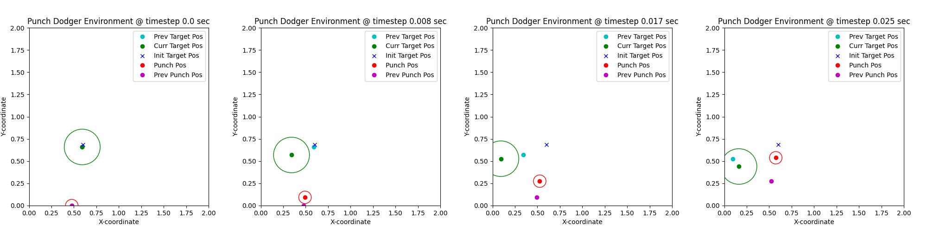
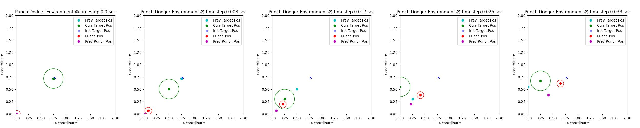
TD3 Normal Model Overfit

Slide 14
Conclusion & Future Work
TD3 Normal Overfit
All the models have similar performance
Physical Hardware Complexities make learning harder
Great Proof of Concept!
Create more complex punch trajectories
Have two punches with alternating delays
Fine tune Rewards

